Slide 1
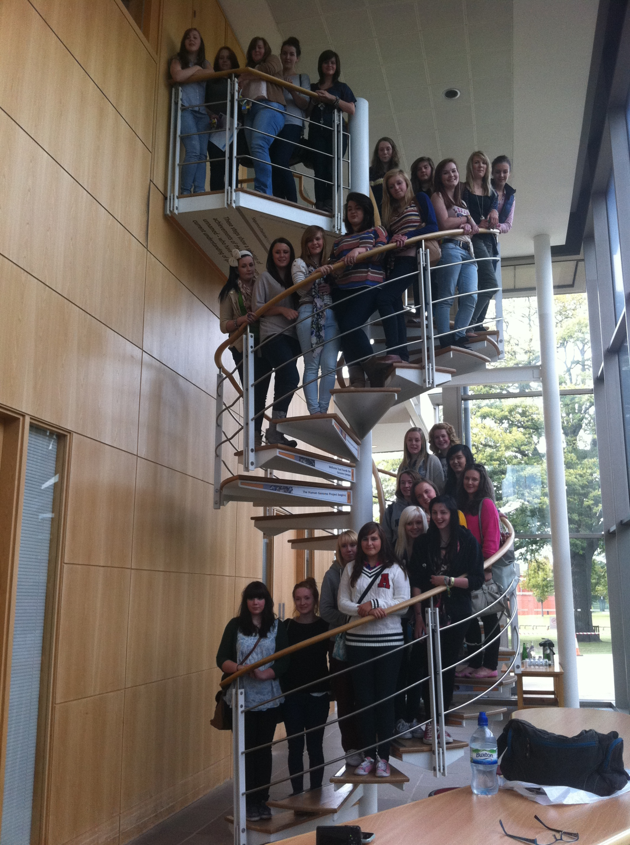
2.5
applied
genetics

Slide 2
Learning outcomes:
2.5.2 understand that mutations are random changes in the:
− number of chromosomes (Down Syndrome); or
− structure of genes (haemophilia)
and can be triggered by environmental factors, such as UV light causing skin cancer;

Slide 3
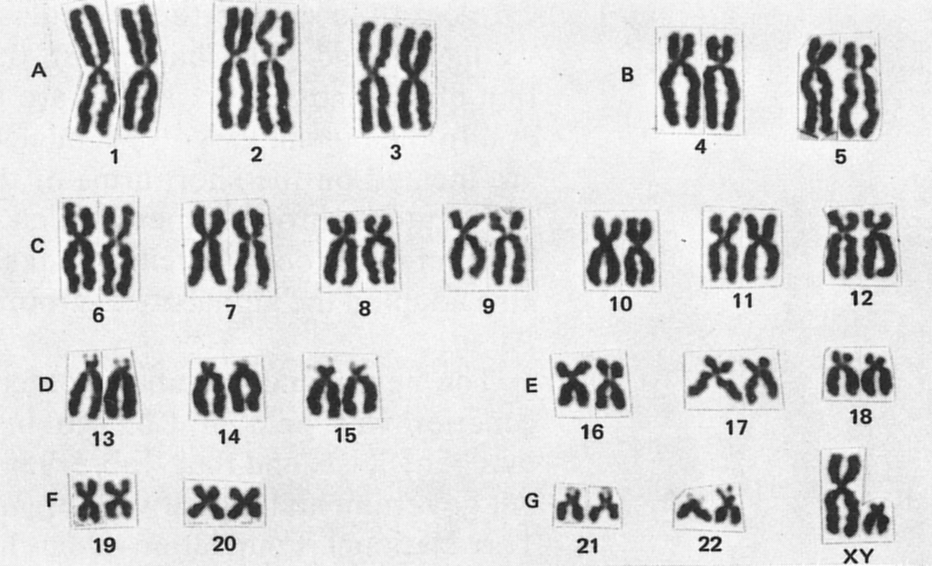
what is this?

Slide 4
a diagram showing
the number
and appearance of chromosomes
is called a
karyotype
chromosomes are arranged
from largest to smallest

Slide 5
the last pair are usually
the sex chromosomes

Slide 6
What is a mutation?
A mutation is a random change to the structure or number of chromosomes or genes.
remember!

Slide 7
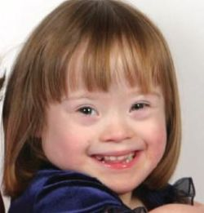
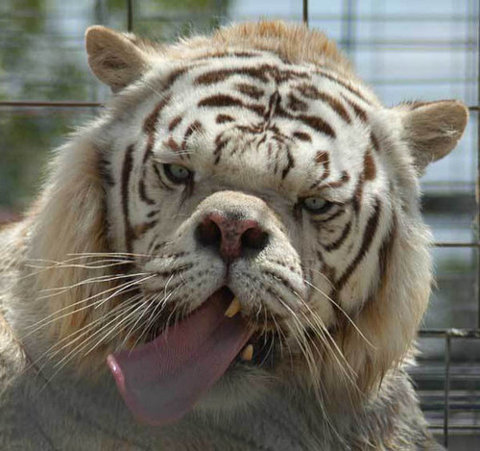
Down's
syndrome
this tiger has
one extra
chromosome
so does
this girl

Slide 8
Down syndrome is an example of a condition caused by a change to the usual number of chromosomes, in this case, an extra chromosome 21.

Slide 9
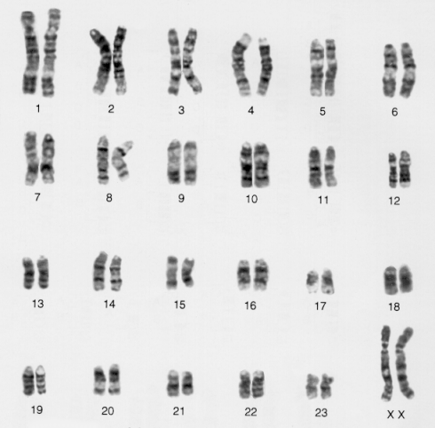
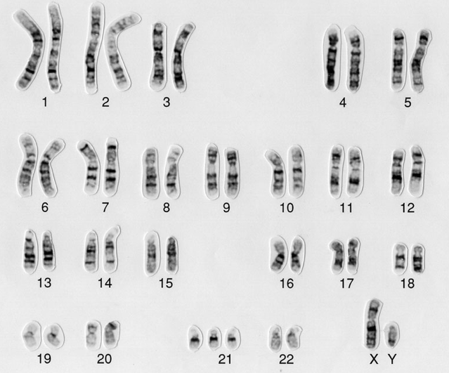
Can you identify two differences
between these karyotypes?
female
down
syndrome
male

Slide 10
Down syndrome
Read the section entitled ‘Down syndrome in more detail’ on p113 GCSE textbook.
Explain why a person with Down syndrome has three copies of chromosome 21.
HINT: what is the usual number of chromosomes in a human gamete?

Slide 11
ovum
sperm
fertilisation
zygote

Slide 12
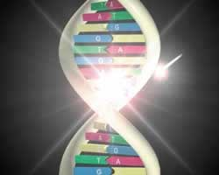
Haemophilia
is caused by a mutation producing a recessive allele instead of the normal dominant allele, that is, a change to the structure of a gene.

Slide 13

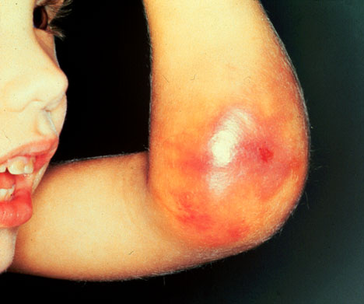
haemophilia

Slide 14
2.5.3 understand the principles of genetic screening and be aware of the ethical issues it raises, to include:
− the dilemma for carriers of genetic conditions in becoming pregnant; and
− abortion following diagnosis of abnormalities after amniocentesis or other tests.

Slide 15
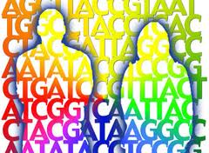
Why is genetic screening needed?
Genetic screening is a scientific test used to determine if a person has a problem with their chromosomes or genes. It may be used to reduce the incidence of diseases or conditions caused by genetic problems.

Slide 16
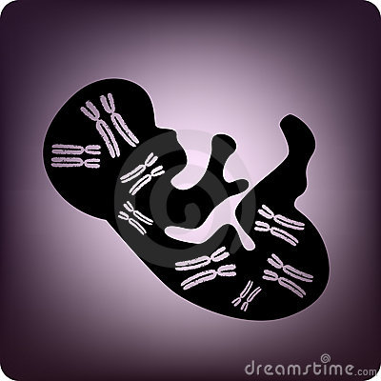
Genetic screening involves testing people for the presence of a particular allele or genetic condition. It and can involve
individuals,
targeted groups or
whole populations.
It is a particular issue for pregnant mothers and their partners.

Slide 17
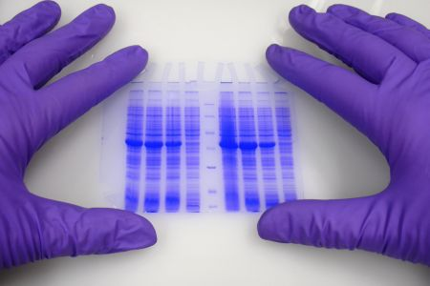

Slide 18
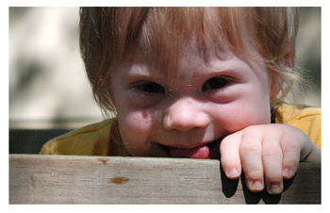
Targeted groups may be
those where the probability of having (or passing on) a particular condition is high
examples include:
screening for breast cancer and
Down syndrome

Slide 19
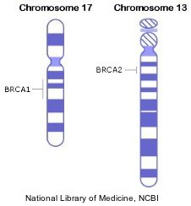
Women in a family where the presence of particular genes
(BRCA 1 and BRCA2) may indicate a high chance of suffering from breast cancer.

Slide 20
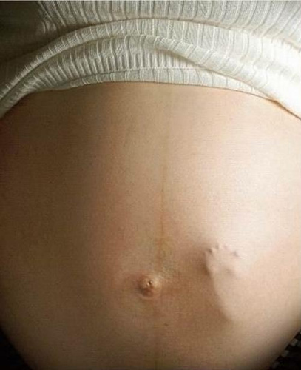
An amniocentesis test is offered to pregnant women in the UK but is probably more important for older mothers, since the chance of having a baby with Down syndrome increases with increasing age.

Slide 21
In genetic screening for Down syndrome:
Cells are taken from the amniotic fluid surrounding the baby in the uterus.
The cells are allowed to multiply in laboratory conditions.
The chromosomes in the cell nucleus are examined to see if the developing foetus has the condition.

Slide 22
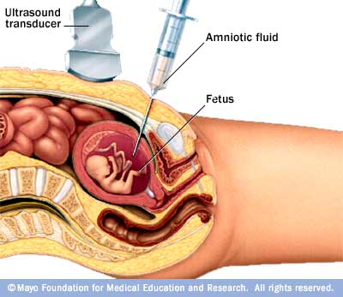

Slide 23
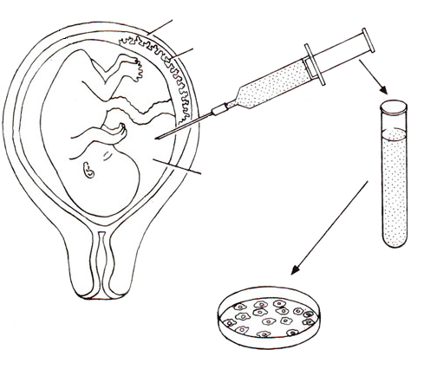
Genetic screening for Down syndrome
uterine wall
Syringe and needle are used to obtain 30 to 40 cm³ of clear fluid containing foetal cells
placenta
amniotic fluid containing cells shed by growing foetus
cells
Cells grown and tested for the presence of 3 copies of chromosome 21

Slide 24
NOT IN BOOKLET
Examples involving genetic screening of whole populations include:
Newborn screening for phenylketonuria
Carrier screening for sickle cell disease
Both can be tested by taking a blood sample

Slide 25
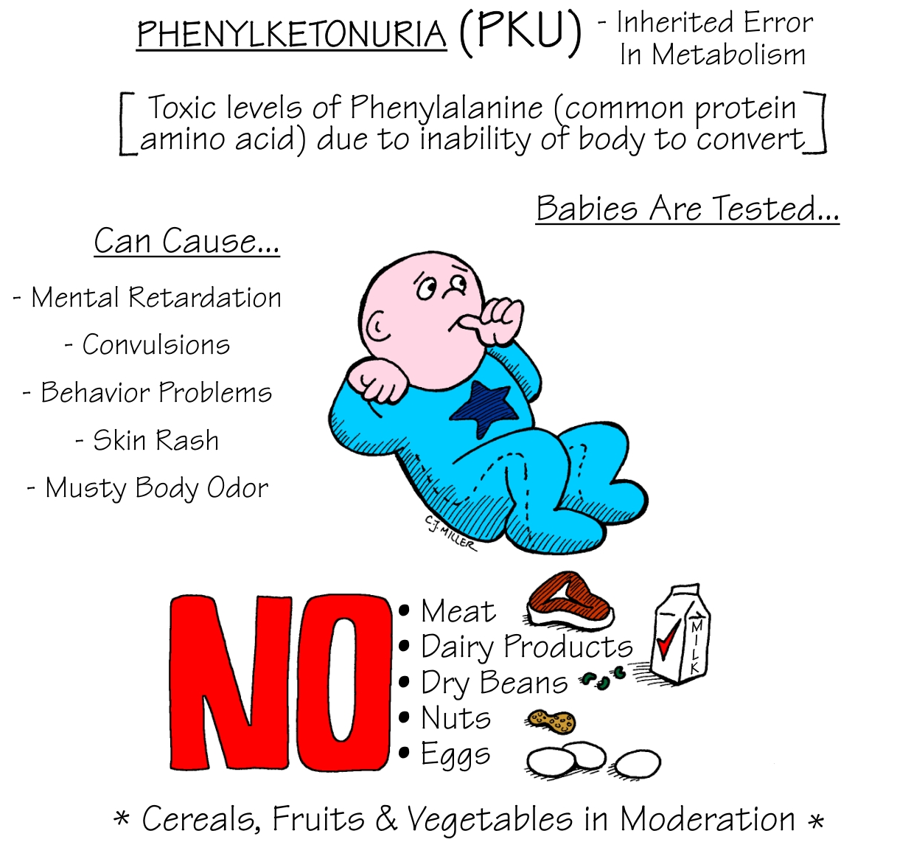
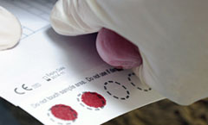
heel
test

Slide 26
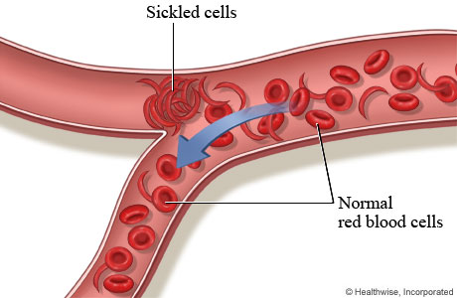
RBCs change shape in low O₂ levels & the sickled cells block blood vessels, causing death.
Carriers have both normal & sickle cells, so have reduced symptoms

Slide 27
Genetic screening – the ethical issues
Potential problems:
Genetic tests cannot always identify the mutation, even when it is present. i.e. they are not 100% reliable.
Detection of a mutated gene does not predict future symptoms. i.e. gives no indication of the severity or age of onset. In some cases the person with the mutation will not develop the disease.
There are considerations for insurance and employment.
There is an emotional impact of discovering you have a mutation and concern for other family members.

Slide 28
Potential problems:
Mothers who know that they or their partner are carriers of a genetic disorder (such as cystic fibrosis) have to consider the potential implications of becoming pregnant. This will include medical care, medical costs, social support, moral, religious and cultural beliefs.
All genetic testing must be backed up with professional support and advice. Information concerning the possible health implications, medical care and support available, choices and options such as preventative surgery, termination of a preganancy, fostering or adoption, as well as emotional support are essential knowledge in any genetic screening programme. One of the core principles is confidentiality.

Slide 29
Questions surrounding genetic screening include:
  What should be tested for?
  Should genetic testing be restricted only to conditions that have a significant health impact? For example, different cultures place different values on the sex of a child. The genetic test results will certainly reveal the sex of the child. If no genetic abnormalities are found, what should be the view if the parents want to terminate the pregnancy simply as a way of choosing the sex of the children in their family?
  Who should place limits?
  Who should be involved in the decisions when the test results become known?

Slide 30
case studies
READ THE CASE STUDIES IN YOUR BOOKLET
Decide whether you are in agreement with the decisions that have been made and explain why.

Slide 31
decision cards
agree
disagree

Slide 32
Walking debate
I believe that women should be allowed to have an abortion for any reason.
I believe that abortions should be carried out for medical reasons only.
Parents should be allowed free choice in whether to have genetic screening or not.
Parents should be allowed to screen for the sex of a child.
Insurance companies should be allowed to see the results of genetic screening for people who apply for insurance.

Slide 33
OPTIONAL
alzheimers

Slide 34
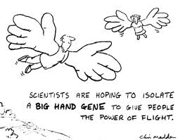
Genetic engineering

Slide 35
Learning outcomes:
2.5.4 understand genetic engineering, to include:
− the basic techniques used to produce human insulin (for the treatment of diabetes) – transfer of a human insulin gene into a plasmid of a bacterial cell to form a genetically modified bacterium which can then be cultured in a fermenter to produce human insulin;
− the use of restriction enzymes to produce ‘sticky ends’;
− the need for downstreaming (extraction, purification and packaging) to produce a pure form of insulin which can be used to treat diabetics; and
− the advantages of producing human insulin (and other products) by this method,
exemplifying how and why decisions about science are made.

Slide 36
Genetic engineering involves taking a piece of DNA, usually a gene, from one organism (the donor) and adding it to the genetic material of another organism (the recipient).
In most cases, DNA that codes for the desired product is incorporated into the DNA of bacteria.

Slide 37
This is possible to do because:
Bacteria have a circular DNA plasmid which is easily manipulated;
Bacteria reproduce very rapidly so large numbers containing the new gene can be produced quickly.

Slide 38
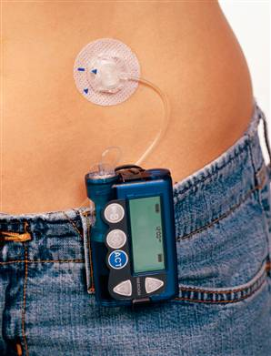
using
genetic
engineering
to treat
diabetes

Slide 39
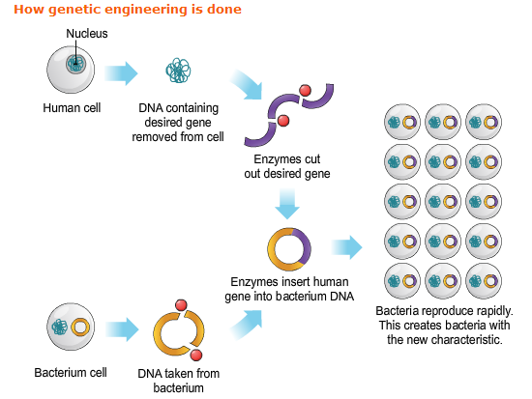

Slide 40
Textbook activity:
Draw Fig 12.3 p116 ‘Genetic engineering – making human insulin’.
Make notes from the pink box on the enzymes used to cut and isolate the human insulin gene and cut the plasmid.
Using the diagram on p117 explain how the human insulin gene and the bacterial plasmid are joined together using ‘sticky ends’.

Slide 41
Treating diabetes
Once the new DNA is placed into the bacteria (they are now genetically modified bacteria), they are allowed to reproduce rapidly in suitable growing conditions (cultured) in special fermenters or bioreactors.

Slide 42
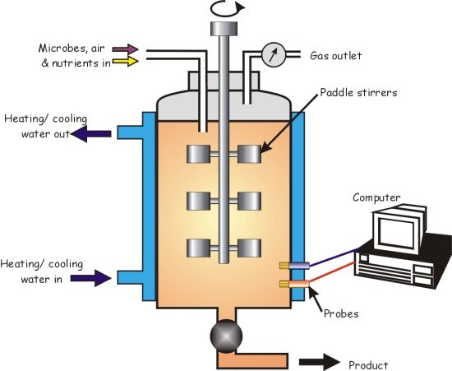
controls pressure
oxygen for respiration
to mix bacteria
and nutrients
cooling to maintain
optimum temp during growth
Steam to sterilise fermenter
and nutrients
before adding bacteria
Monitors pH, temp
bacteria and insulin OUT

Slide 43
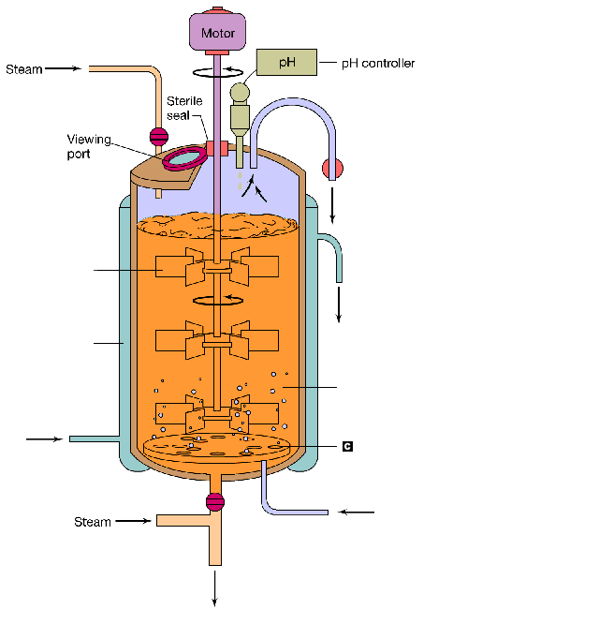
A fermenter
waste gases OUT
paddle
to mix bacteria
and nutrients
warm water OUT
cooling jacket
to maintain
optimum temp
Solution containing
bacteria and nutrients
cold water IN
air bubbled IN
oxygen for respiration
to sterilise fermenter
and nutrients
before adding bacteria
bacteria and insulin OUT

Slide 44
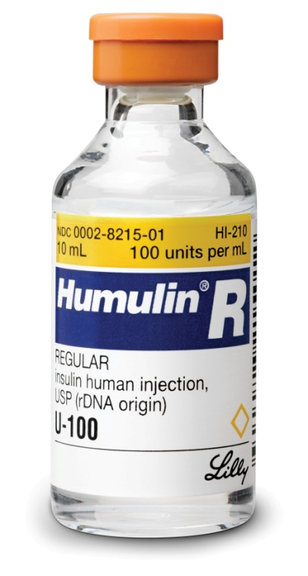
Downstreaming
This is the process that must be carried out after the insulin is produced by bacteria,to produce a pure form of insulin to be used for medical purposes. It involves:
Extraction of insulin from the fermenter;
Purification of insulin;
Packaging of insulin.

Slide 45
In general, genetic engineering produces pure forms of medical and non-medical products more quickly, more cheaply and in greater quantities than by older extraction methods.

Slide 46
Human insulin is produced by genetically modified/engineered bacteria.
Previously the insulin given to diabetics was obtained from the pancreas of domestic animals such as pigs and cattle.
This was limited by the number of animals brought to abattoirs for slaughter and it was a slow extraction process.

Slide 47
The non-human insulin previously used to treat diabetes differs in structure from human insulin and was not as effective for humans.
Genetically engineered human insulin overcomes these problems.

Slide 48
HIGHLIGHT THE FOLLOWING IN YOUR NOTES
Advantages of genetically engineering human insulin
Disadvantages of using non-human insulin to treat diabetes.

Slide 49
Review
Complete questions 1 – 3, p118-119 textbook.

Slide 50
6 MARK ANSWER
An enzyme cuts an insulin gene out of a human chromosome.
Bacteria contain a circle of DNA called a plasmid.
A plasmid is taken out of a bacterium and is cut open using the enzyme.
The plasmid and insulin gene are mixed together and they join together forming a circle.
The plasmid containing the insulin gene is put back into a bacterium.
Many bacteria are put into a huge fermenter where the bacteria multiply.
The fermenter contains all the nutrients needed for the bacterium to make insulin.
The insulin is secreted from the bacterial cells
Downstreaming: extracts, purifies and packaging insulin.

Slide 51

human chromosome
enzyme cuts
out gene
insulin gene
1.
An enzyme cuts the human gene
from the human chromosomes

Slide 52
2.
Enzyme used to cut open
a ring of bacterial DNA,
called a plasmid

Slide 53
3.
human gene
and
plasmid are
mixed together
4.
human gene
joins into
plasmid

Slide 54
5.
Plasmid placed in bacterial cell

Slide 55
6.
Bacteria are placed in a fermenter,
where they grow and divide.

Slide 56
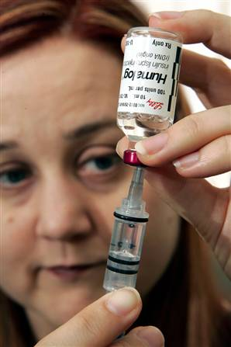
7.
As bacteria grow they produce the protein insulin.
The bacteria and insulin are separated
and the insulin packaged for sale.

Slide 57
