Slide 1

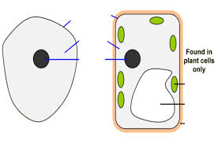
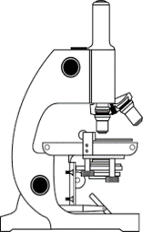
i
Cell, Tissues & Organs
M
A
Define
tissue
Organ
Organ system
Organism
Explain diffusion
What is a stem cell?
List some ethical issues
Structure | Purpose | Plant/Animal/Both
 | Controls the cells activities
Cytoplasm
 |  | Both
Nuclear membrane
 |  | Plant
 | Contain chlorophyll, absorb light energy to make food
Vacuole
Label the Cells
Label the microscope
Explain how plants and animals grow
Explain how to make an onion cell slide.
Draw and label a bacterial cell
KEY WORDS:
Nucleus Vacuole
Cellulose cytoplasm
Chloroplast chromosomes
Coverslip magnification
Plasmid diffusion
Selectively permeable
differentiate
ASSESSMENT:

Slide 2
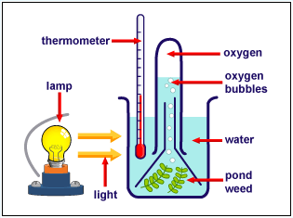
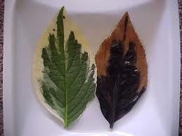
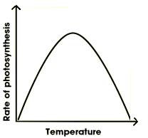
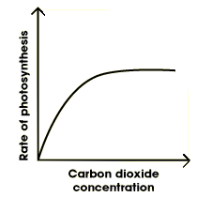
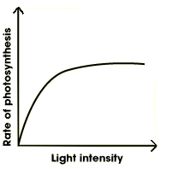
Write down the equation for photosynthesis.
Explain why chlorophyll is needed in photosynthesis.
What is the compensation point?
Label the leaf
2.3 Photosynthesis
How is this used to calculate the rate of photosynthesis?
Explain this result:
What is the glucose used for from photosynthesis?
How and why would you destarch a plant?
Light absorption in a leaf is maximised by:
Describe and explain what would happen in these 3 tubes?
How could you increase the rate of photosynthesis in a greenhouse?
Explain how to carry out a starch test.
What are the limiting factors on these graphs?
Gas exchange in a leaf is maximised by:

Slide 3
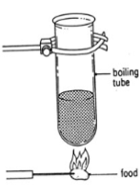
Nutrition and Health
How is this used to calculate the energy in food
Write the equation
What 3 things determine our energy needs?
What is obesity?
How do you calculate
BMI
BMR
Food group | Made up of | Function | Source
 |  | Growth and repair
Fats
 | Vitamin C
 | Vitamin D
 | Calcium
 | Iron
 | Transport medium, chemical reactions, component of cytoplasm and body fluids
Carbohydrate
Fibre
Describe the health problems which could be caused by poor diet.
Food test | Method | Positive result
Iodine (starch)
Benedicts (sugar)
Biuret (protein)
Ethanol (fats)
DCPIP (vit C)
KEY WORDS:
Nucleus Vacuole
Cellulose cytoplasm
Chloroplast chromosomes
Coverslip magnification
Plasmid diffusion
Selectively permeable
differentiate
ASSESSMENT:

Slide 4
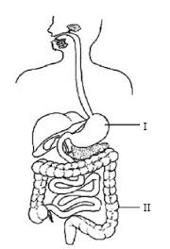
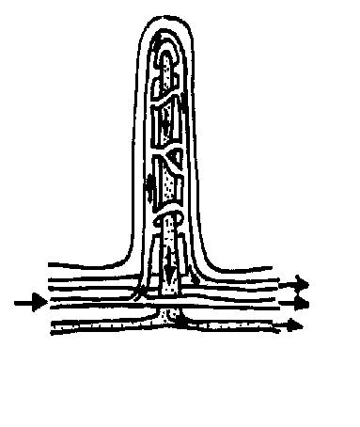
DIGESTION - breakdown of large insoluble molecules to small, soluble ones.
Annotate the following diagram (include what the structure does and any enzymes/juices produced)
Where would you find this structure?
Label the diagram
Explain how the villus is adapted to it’s function
KEY WORDS:
Villi
Digestion
Egestion
Emulsify
Permeable
Absorption
ASSESSMENT:
Notes:
4

Slide 5
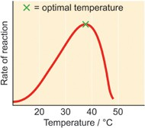
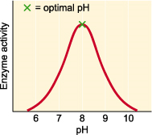
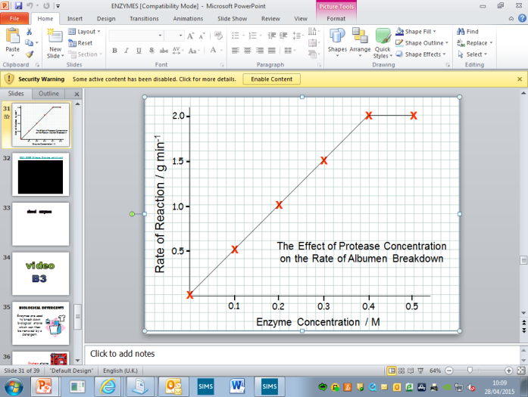
Enzymes
How enzymes work.
Explain enzyme specificity.
What is a the role of an enzyme?
What is the Lock and Key model?
Factors Affecting Enzyme Action.
Draw and label a diagram to show how an enzyme works. Label the substrate, enzyme, active site
.
Explain the following graphs
Definition of an enzyme
Biological Detergents
Enzymes in Digestion
Explain how biological detergents work.
What are their advantages and disadvantages?
Enzyme |  |  | Area of gut
Amylase
Protease
Lipase
carbohydrase
Substrate
Product
KEY WORDS:
Denatured
Enzymes
Active Site
Specificity
thermostable
ASSESSMENT:
Notes:
5

Slide 6
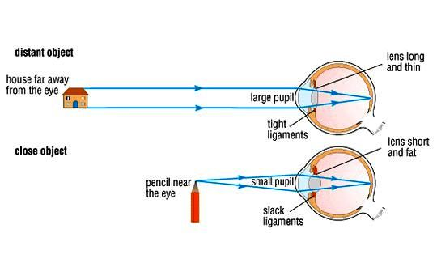
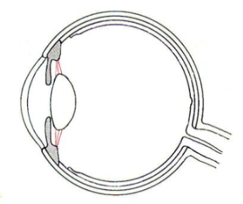
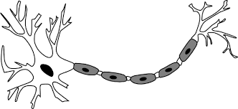
The Nervous System
Responding to change
Label the eye
Focusing an image
Stimulus receptor CNS effector response
Name 3 receptors and 2 effectors
What is the CNS?
Object | Ciliary Muscles | Suspensory Ligaments | Lens shape
Distant
Close
Reflex Actions
On the diagram label the different neurones, receptor and effector.
Pupillary Reflex
Light | Radial muscles | Circular muscles | Pupil size
Bright
Dim
Why are reflex actions important?
Why is this important?
Explain how an impulse can cross a synapse
KEY WORDS:
Stimulus
Reflex
Synapse
effector
synapse
Receptor
Neuron
ASSESSMENT:
Explain how the neurone adaptations help it do its job
Long
Insulating sheath
Branched ends
Notes:
6

Slide 7
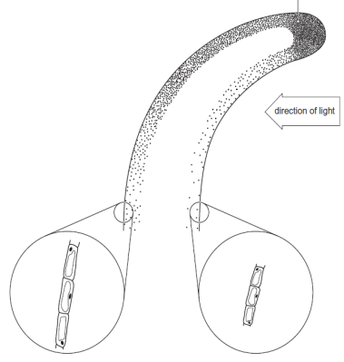
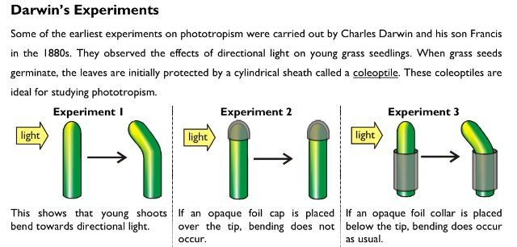

HORMONES
Compare and contrast nervous control and hormonal control.
Name 4 hormones and explain what they control
Plants are sensitive to ________, __________ & _________
What is the response of plant shoots to light called?
Why is this response so important?
What causes it to occur?
Annotate the following diagram
Explain the following experiment
Where is insulin produced?
What does it do specifically?
Draw a flow diagram to show how it works.
Explain negative feedback
What other hormone is involved and what does it do?
What is Diabetes?
Symptoms
How is it treated?
Name the 2 types of diabetes. Explain
What are the long term effects?
Name and explain the ways plant hormones can be used by growers.
KEY WORDS:
Phototropism
Auxin
Negative feedback
Diabetes
Pancreas
Hormone
Tissue culture
ASSESSMENT:
Notes:
7

